Slide 1
Soft Programming Disturbance: Critical Transmission Path & Shallow Trap in BETOX Region 20250731 진명

Slide 2
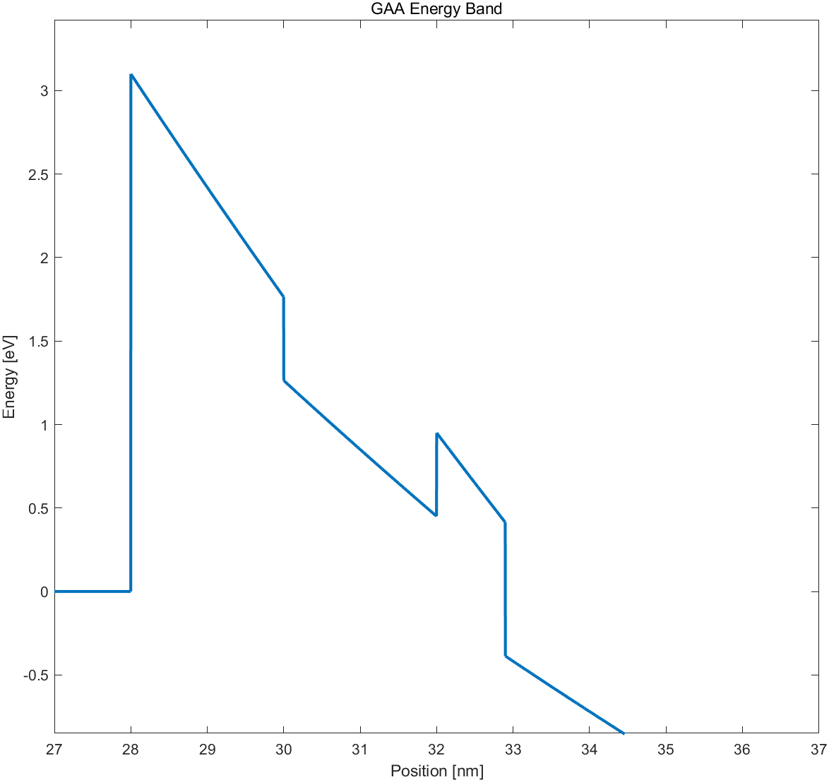




Elastic Trap-Assisted Tunneling
V_{g} = 7 – 11 V : Elastic Trap-Assisted Tunneling
BETOX
CTN
$c_{n} , e_{n}=$ $\frac{2π}{ℏ} {\left|E_{T}\right|}^{2}V_{T}$ $×\frac{\sqrt{2m^{∗}}m_{0}}{π^{2}ℏ^{3}}\sqrt{E_{trap}−E_{C,r}}$ $×\frac{1}{1+\exp\left(\frac{E_{trap}−E_{C,r}}{kT}\right)}$
$×\left|TC\right|$
Si
$ν$
o1
n1
o2
Attempt-to-escape
Frequency
Band to Trap Capture
Trap to Band Emission
Fermi-Dirac
Distribution
$$c_{n}$$
$$e_{n}$$
Tunneling Probability
Detrapping 논문 모델링

Slide 3








Modeling Equations
Band to Trap Capture
$\frac{dn_{t_tn1}}{dt}=c_{n}\left(N_{t}−n_{t_tn1}\right) −e_{n}n_{t_tn1}$
①
Trap to Band Emission
$\frac{dn_{t_ctn}}{dt}=e_{n}n_{t_tn1}$
②
①
②
$\frac{dn_{t_tn1}}{dt}=c_{n}\left(N_{t}−n_{t_tn1}\right) −e_{n}n_{t_tn1}$
$\frac{dn_{t_ctn}}{dt}=e_{n}n_{t_tn1}$
$\frac{dn_{t_tn1}}{dt}+\left(c_{n}+e_{n}\right) n_{t_tn1}=c_{n}N_{t}$
$$n_{t_ctn}=e_{n}n_{t_tn1}t$$
$\left(∵n_{t_ctn}\left(t=0\right)=0\right)$
$n_{t_tn1}=$ $n_{0}\exp\left(−\left(c_{n}+e_{n}\right)t\right)$ $+ \frac{c_{n}}{c_{n}+e_{n}} N_{t} ∝N_{t}$
Converging term
Constant
① + ②
$n_{t_ctn}=$ $\frac{c_{n}e_{n}}{c_{n}+e_{n}} N_{t} t$

Slide 4





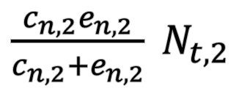
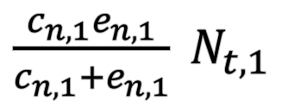
Modeling Equations
① + ②
$n_{t_ctn}=$ $\frac{c_{n}e_{n}}{c_{n}+e_{n}} N_{t} t$
$N_{t}$: Transmission Path 에서의 local trap density
$\frac{c_{n,1}e_{n,1}}{c_{n,1}+e_{n,1}} N_{t,1}$
$\frac{c_{n,2}e_{n,2}}{c_{n,2}+e_{n,2}} N_{t,2}$
$$c_{n,1}$$
$$e_{n,1}$$
path 1
path 2
$$c_{n,2}$$
$$e_{n,2}$$

Slide 5
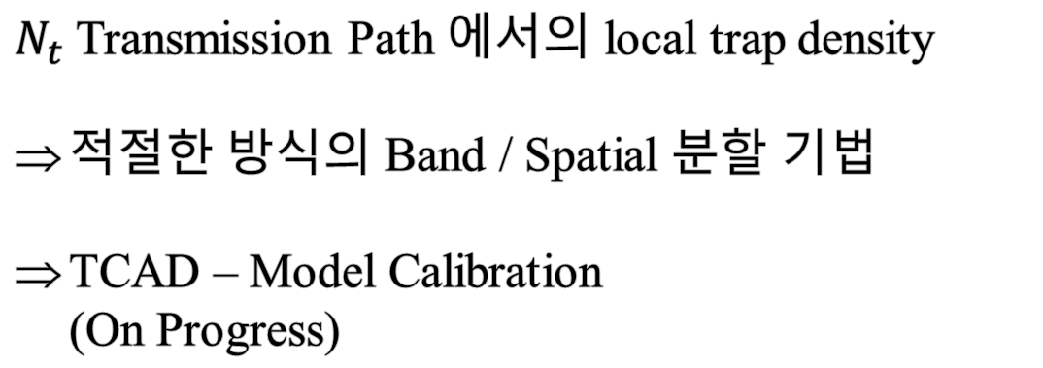
Future Works
$N_{t}$Transmission Path 에서의 local trap density
적절한 방식의 Band / Spatial 분할 기법
TCAD – Model Calibration (On Progress)

